Slide 1
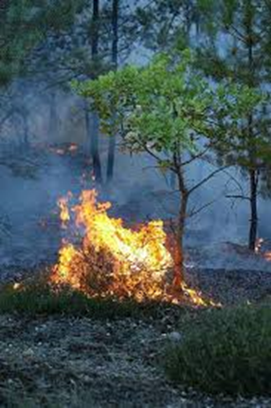
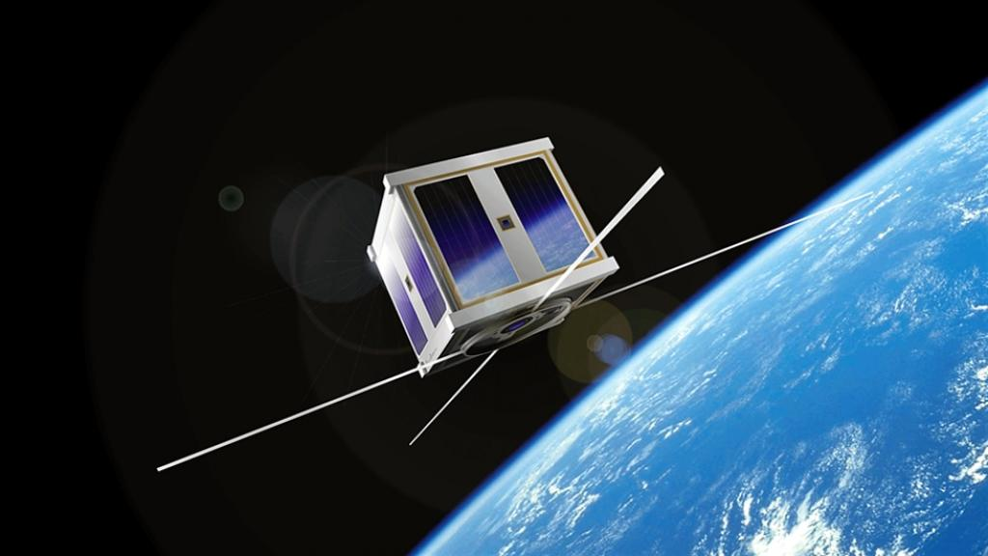
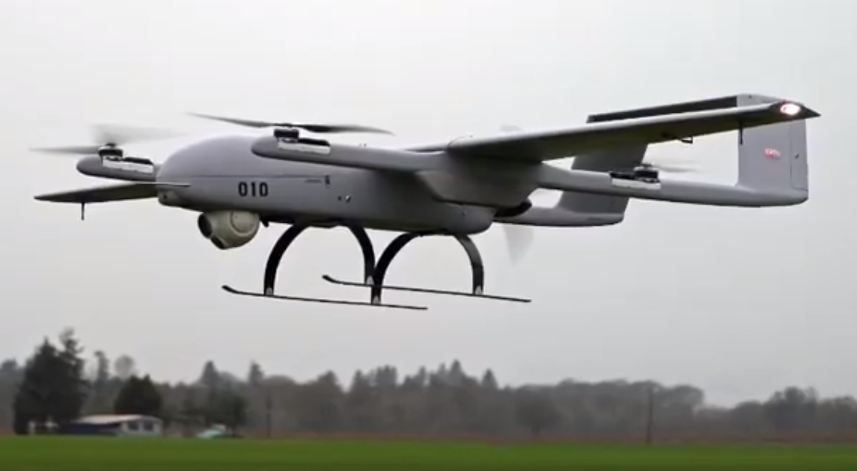
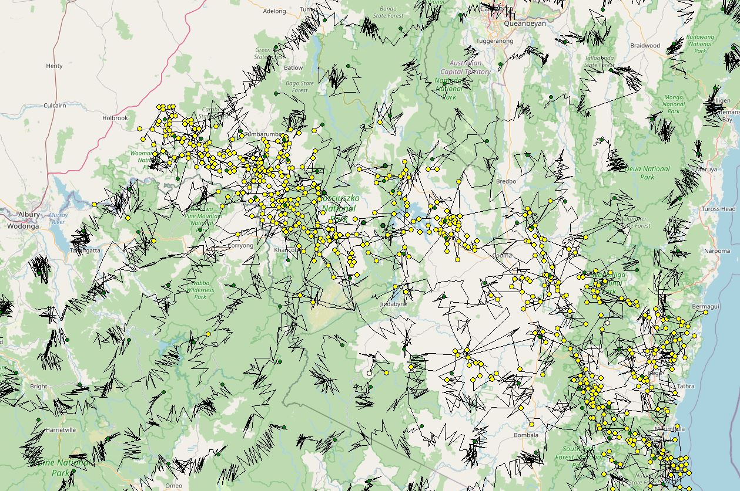
ANU-Optus Bushfire Research Centre of Excellence
Associate Professor Marta Yebra
Director, ANU National Bushfire Initiative
Fenner School of Environment & Society
School of Engineering
^{@myebra12}
Notes:
On behalf of the members of the Emergency Management Spatial Information Network Australia (EMSINA) we are pleased to offer you an opportunity to present at our next meeting (online) on 31 March 2021. The black summer fires of 2019-20 and ensuing inquiries have prompted many new projects and initiatives. With this in mind, the theme of the next meeting is “Discovering and understanding the latest initiatives in EM, with a particular focus on spatial data exchange to aid EM preparedness and operations”. Presentations will be approximately 20 mins long. You are encouraged to attend the whole day as we will have 2 sessions of presentations.

Slide 2
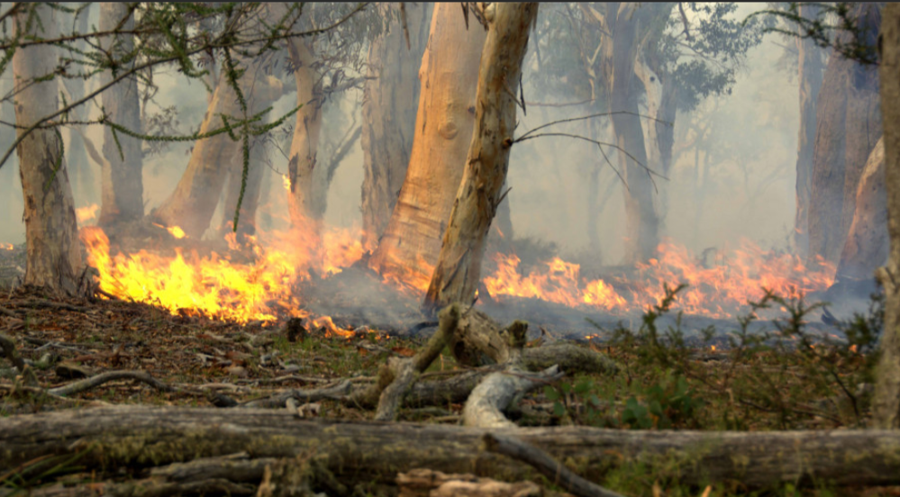
ANU Bushfire Initiative
Current methods cannot beat catastrophic fire conditions
Remote lightning ignitions cause most of the damage
Inability to control large fires a key factor in 2019-2020
After ignition, time is limited to act before the fire is too large
Detect and extinguish ignitions before they spread and become hazardous
Faster is better.
Changing the way we fight fires

Slide 3
Detect and extinguish a small bushfire before it can spread
Artist's impression of our aspiration

Slide 4
ANU Bushfire Initiative: Research Programs
1. Prevention & risk reduction
Implement and evaluate the effectiveness of novel and existing fire risk reduction strategies – ecological approaches.
2. Lightning forecasting & detection
Lightning - 80-90% area burnt 2019-20
Forecast lightning strikes
Predict lightning strikes that ignite fires
3. Ignition detection
Optimise layered technologies:
Ground-based cameras
Sensors and IoT
Drones
Balloons
Satellites
ANU-OPTUS CoE
4. Data analytics and communications
Analyse and communicate detection data rapidly to suppression vehicle
5. Safe and rapid suppression
Deploy innovative technologies – water gliders - to suppress fires
6. Legal & economic analysis
Existing regulatory regime around airborne technologies and risk appetite during crisis
Economic analysis of options for detection and suppression

Slide 5
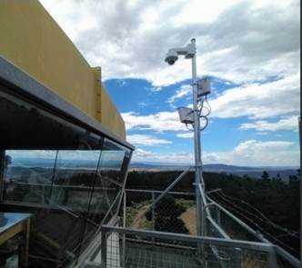
ANU-Optus Bushfire Research CoE
Detection – an optimised and layered approach combining satellites, drones, balloons and networked IoT ground sensors:
Detectors on satellites can inspect large areas but cannot “see through” clouds.
Drones detect smaller fires than satellites, fly below cloud cover and do accurate fast surveys of lightning ignitions at night
Ground sensors/cameras on towers have limited fixed coverage in strategic locations and are inspecting continuously
High Altitude Balloons / Drones maintain continuous coverage over high risk regions, providing telecommunications
The ambitious program will run until 2025.

Slide 6
ANU-Optus Bushfire Research CoE
First year projects
Detection – an optimised and layered approach combining satellites, drones, balloons and networked IoT ground sensors:
Detectors on satellites can inspect large areas but cannot “see through” clouds.
Drones detect smaller fires than satellites, fly below cloud cover and do accurate fast surveys of lightning ignitions at night
Ground sensors/cameras on towers have limited fixed coverage in strategic locations and are inspecting continuously
High Altitude Balloons / Drones maintain continuous coverage over high-risk regions, providing telecommunications
Evaluation of Detection Techniques!

Slide 7
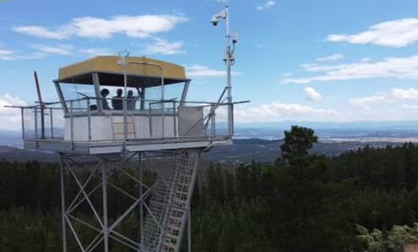
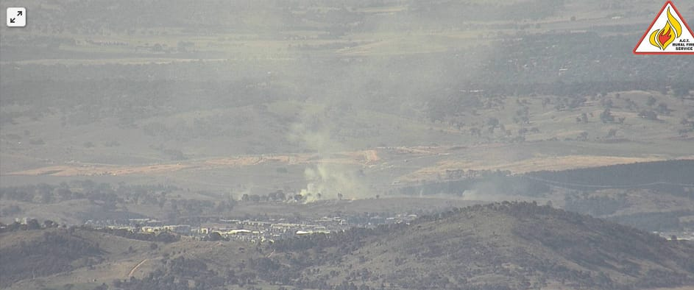
Tower Camera based Video Analytics for Early Bushfire Detection
Provide a reliable and trustworthy detection capability within the current ACT Rural Fire Services Proof of Concept, and further deployments of this capability in other jurisdictions.
High-quality cameras, parallel GPU computing for fast image processing, and new techniques for Deep Learning
Kowen Forest Tower, one of the 4 fire towers with video monitoring capability
deployed by ANU, Optus and Minderoo in collaboration with ACT-RFS

Slide 8
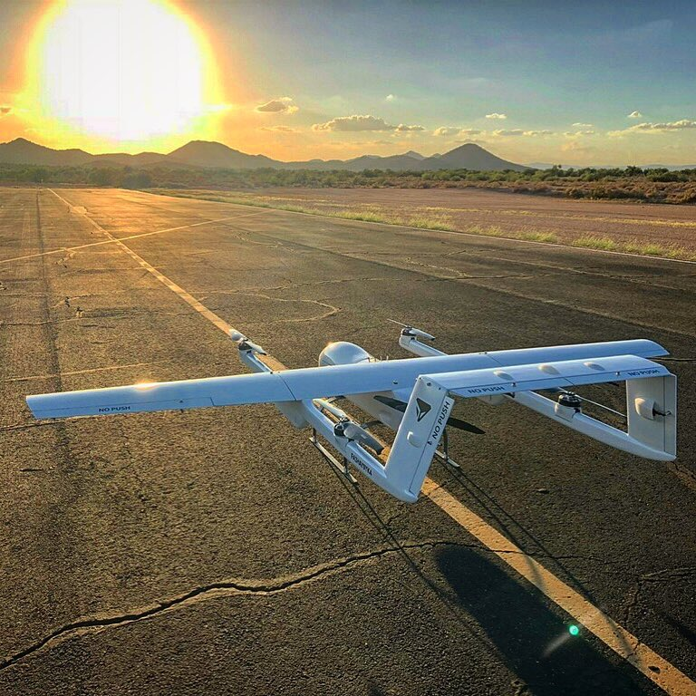
Surveillance drones over Namadgi NP
Thermal imagery to find lightning ignitions
Fly in dangerous and difficult conditions
Deployed close to lightning storms to detect lightning ignitions in minutes
Fast, all weather, day/night​

Slide 9
Evaluation of Detection Techniques
Detection techniques
000
Fire lookout observers
Cameras
Fire observer operator looking at the screen in a control centre (ACT-RFS)
Crowdsourcing – using online platform (BushfireLive)
Automatic AI algorithm
Drone detection
Existing satellite capability
What are we testing?
Fire detection rate
Time to report (only possible with experimental or prescribed fires)
Location accuracy
Fire size and shape at the time of registering (from drone footage)
Indicator of fire intensity (radiative power or colour of the smoke)

Slide 10
ANU water gliders designed and prototyped to suppress fires while they are small
dropped from transport aircraft (C-130) on standby in the air over high-risk areas
GPS guided autopilots
half tonne of water per glider
all weather, day/night operation, all terrain
burst above ground for area affect
low-cost disposable water gliders
biodegradable materials
Fast, all weather, day/night​

Slide 11
So far, ANU calculations for SE Australia show that
Detection
1000 fire scout drones at 85km/h, average detection time of 6 minutes for 2000 lightning strikes in 24 hours for study area ($200 million capital cost)
If the drones speed up to 125km/h then only require 200 drones ($40 million).
Combine improved lightning forecasting and detection and predicting of ignitions with ground sensors, satellites - 1 minute response.
Suppression (not yet costed)
9 x C-130 jets stationed at 9 existing airfields across region
Payload of 32 500kg water gliders
4 water gliders deployed per ignition
Less than ten minutes to extinguish
lightning strikes
drones

Slide 12
Ozfuel
The ANU OzFuel microsatellite demonstrator – an infrared sensor system with edge AI processing – aims to address the need for more efficient national monitoring of fuel conditions and bushfire prevention
Medium term: OzFuel to provide an innovative SWIR vegetation condition sensor system (tuned to eucalypt forest) from concept to pre-flight maturity
Longer term to operate Ozfuel from LEO to provide near-real time information
https://inspace.anu.edu.au/activity/missions/ozfuel

Slide 13
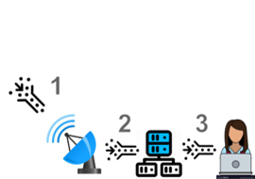
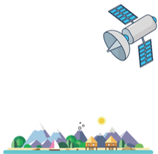
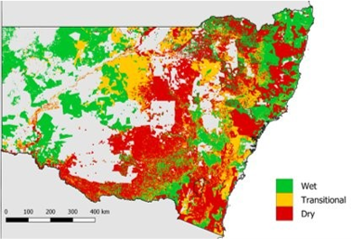
Real Time Data Analytics
Scope
The deployment of technology for early fire detection and response needs to be informed by an understanding of the likehood of an ignition occurring which in turns depend on fuel flammability
Monitoring fuel flammability, lighting ignition likelihood and fire detection in real time requires a constant stream of high-resolution imagery.
The required generated data exceeds the bandwidth, computational and storage capacity of our current systems
Research Goals
This program aims to evaluate efficient ways to store the large volume of generate data and compute algorithms to convert that data into the required information on fuel flammability, lighting ignition and active fire location in real-time
Innovations
Application of on-board AI processing to:
image compression to detect redundancies and reduce data volume (low bandwidth links)
Correct/process remote sensing imagery as it is captured
Rapid estimation of fuel flammability conditions, lighting ignition likelihood and fire detection.

Slide 14
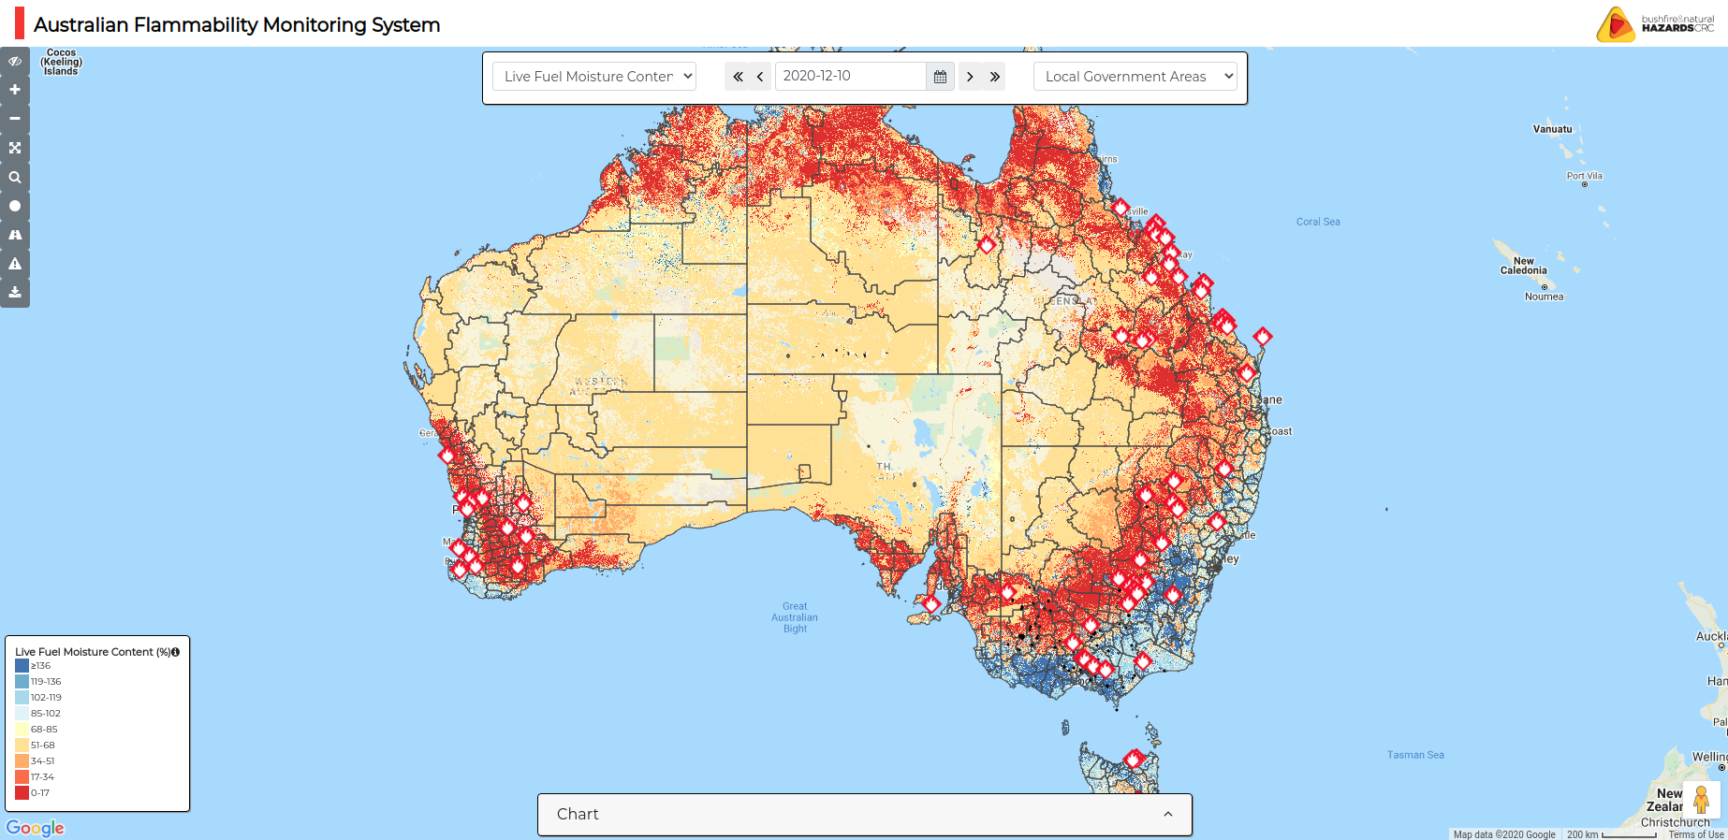
Real time Data Analytics
8200x6800 pixels/time
x 73 times/year
x 4 bytes/pixel
15 GB/year x 2500 = 36 TB/year
(with compression) = 0.5 TB/year
WALD xc0 allocation = 15 TB
GA DEA rs0 allocation = 500 TB

Slide 15
Summary
The ANU-Optus partnership is the core of an aspirational approach that is paramount to reducing the future likelihood of catastrophic bushfires.
Contact us if you are interested in contributing to or participating in this or the broader ANU Bushfire Initiative

