Slide 1
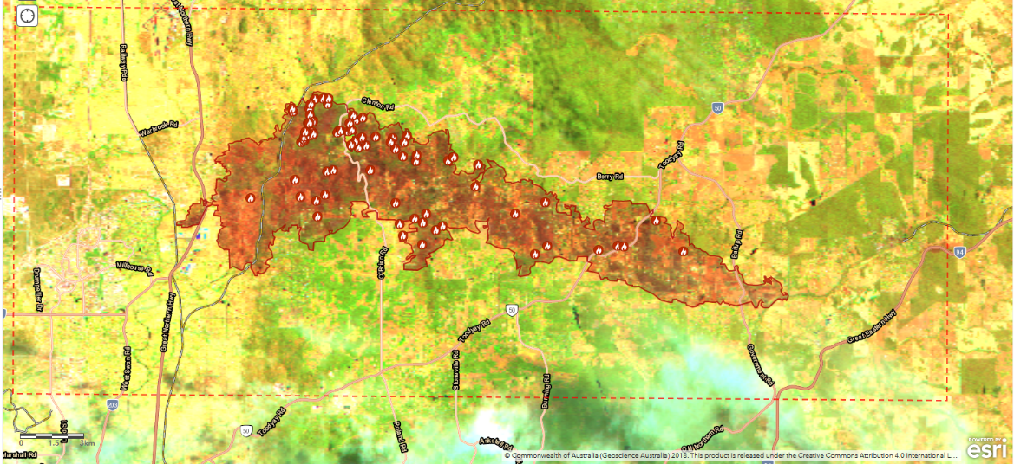
ESA AI and Cloud Processing Wildfire Project
Norman Mueller
Director of Product Development
Digital Earth Australia

Slide 2
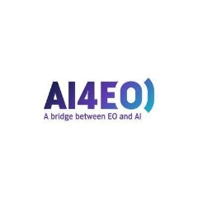
ESA AI4EO Wildfires: Summary
8-month project started in December 2020
Project objective is to develop and demonstrate a burnt area mapping service that uses an AI-enabled algorithm to process EO data (specifically Copernicus Sentinel-2).
It is envisaged that this service may improve and complement existing approaches, by incorporating three aspects:
AI-enabled algorithms have been demonstrated to have performance improvements over traditional methods
Increase in the availability of satellite EO data is expected to help improve operational capabilities
Scalable cloud-computing removes technical barriers on users finding and instigating processing services.
The service will be demonstrated on the EO4SD Lab, an online portal that provides a range of tools and processing services along within extensive EO data archives.
Goal is to create a demonstration service that helps meet the performance and operational needs of the fire monitoring community
CGI

Slide 3
Consultation with Australian EM Community
We’ve consulted not just emergency managers but also the broader community interested in other applications like carbon inventory. Responses from:
DISER (carbon inventory, climate change)
NSW RFS
WA DFES
Qld DES / JRSRP
NAFI / CDU
Vic DELWP

Slide 4
Overview of Feedback
Pre-fire: Providing information such as fuel hazard measures and time since last burn to assist fire prevention activities.
During-fire: Providing near real-time detection and location of active fire areas.
Post-fire: Providing mapping and assessment of burned areas.
Consistent requirements across jurisdictions:
High speed / low latency burn scars and severity
Accurate burn scars to enable combination into fire history going back to 1990

Slide 5
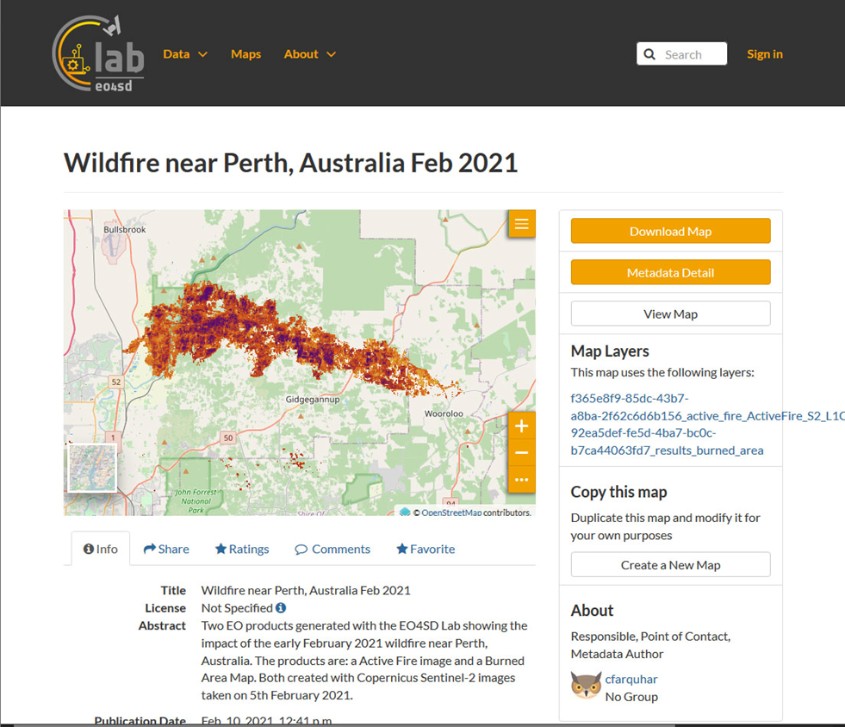
Status so far
AI4EO is in demonstrator phase
Draft overview report
Demonstrator web portal:
https://geonode.eo4sd-lab.net/maps/2223

Slide 6
GA activities in this space
Climate and Resilience Services Australia (CaRSA)
GA / DEA has prioritised upgrading services to support EM and CaRSA
Near Real Time Sentinel-2 and Landsat-8 with corresponding flood and fire extents
solidifying our processing pipelines to make these services genuinely 24/7 operational with associated web service delivery
Recruited a Business Analyst to refine the AI4EO feedback into more definite requirements and scope next steps
will be reaching back out to the jurisdictions for further feedback

Slide 7
NRT Outputs with Hotspots Overlayed

Slide 8
NRT Flood Outputs

Slide 9
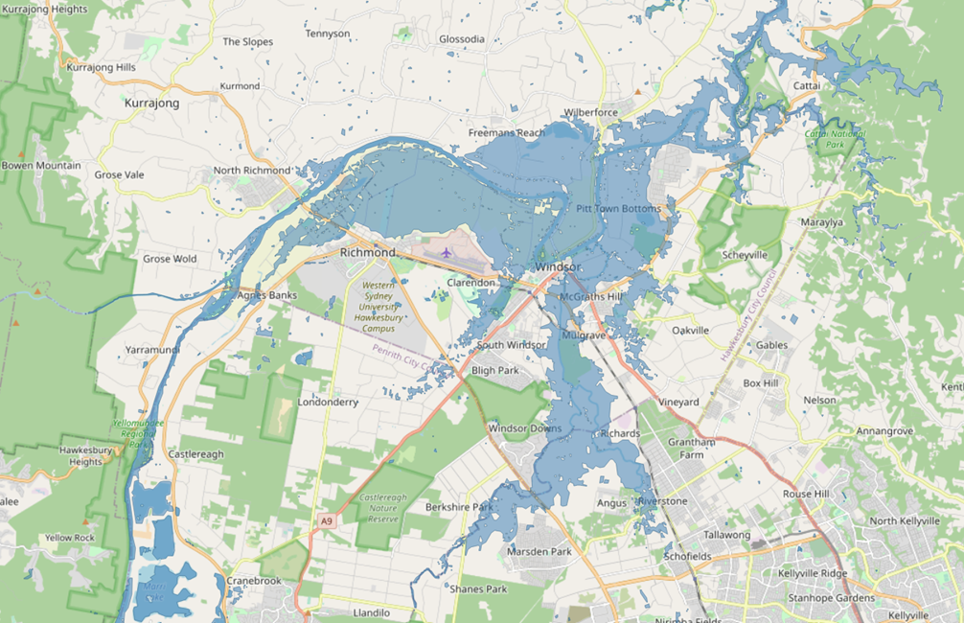
Questions?

