Slide 1
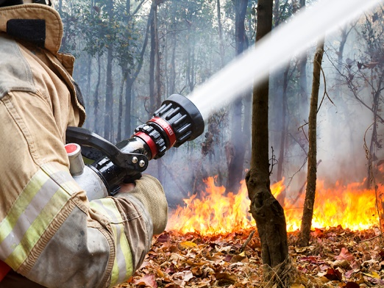
Digital Earth Australia Hotspots
Maggie Arnold
31 March 2021
https://hotspots.dea.ga.gov.au/

Slide 2
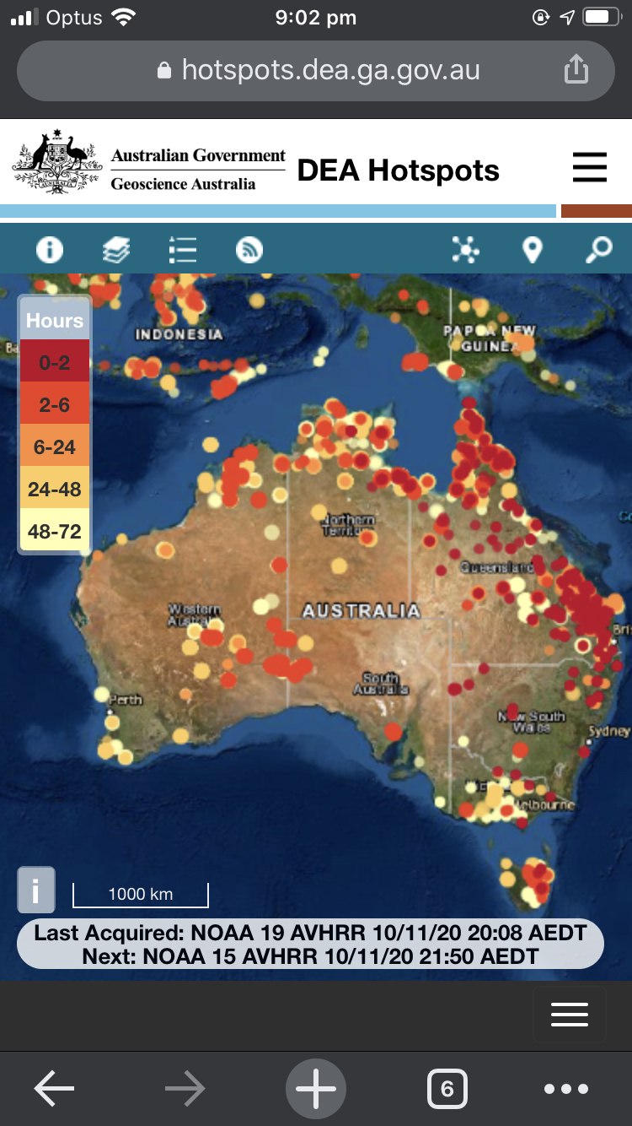
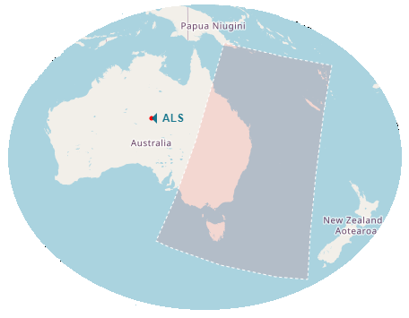
Overview
What is DEA Hotspots?
How it works
Who uses it?
Impact
Team effort
The future
Notes:
I’d like to talk to you about DEA Hotspots; what it is, how it works, who uses it, the impact it has had, and the future. First of all, data is received via Satellite data reception, Data transfer to AWS Sydney, where the data is stitched from multiple ground stations feeds.
Hotspot algorithms from different groups are run to determine where hotspots are, and then inserted into a PostgreSQL database and published as web map services, which are then displayed on the website

Slide 3
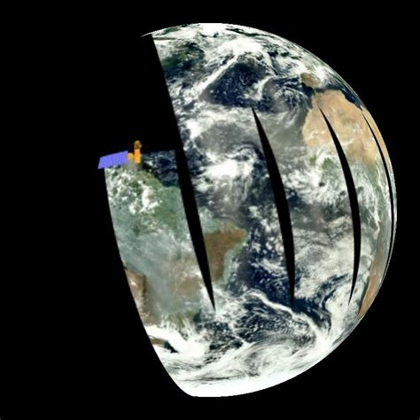
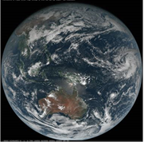
DEA Hotspots satellite sensors
Direct reception
Polar orbiter
AVHRR (NOAA-19)
VIIRS (Suomi NPP & NOAA-20)
MODIS (Terra & Aqua)
Internet transfer
Geostationary orbit
AHI (Himawari-8)
Portals for emergency management
Notes:
Hotspots are derived from multiple sensors, from polar orbiting satellites like AVHRR, VIIRS and MODIS, which provides imagery over certain areas and certain periods of time, and
Geostationary orbits, like the Himawari 8 satellite, with the AHI sensor, provide imagery continuously over the same area as they follow the earths rotation.

Slide 4
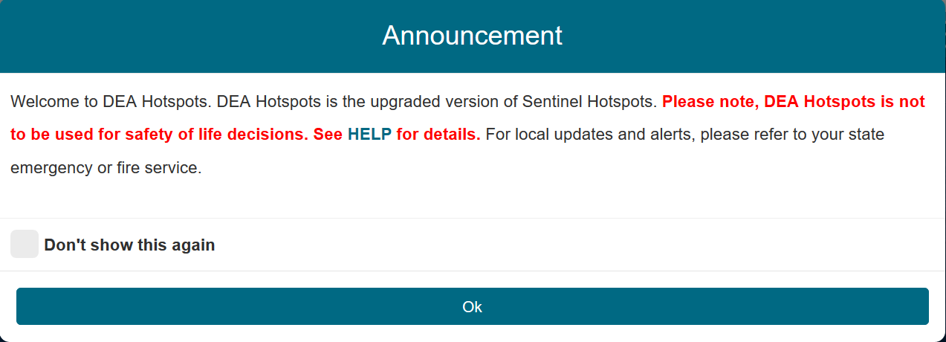
DEA Hotspots
Geoscience Australia operates the Digital Earth Australia (DEA) Hotspots service providing 10 minute updates on potential fires from satellite data to emergency services and the public.
DEA Hotspots replaces Sentinel Hotspots and includes a number of improvements that ensure continuity of service.
Notes:
Initially called Sentinel Hotspots, CSIRO created the prototype in the early 2000’s. GA assumed operations ~2005.
It has since morphed to a National Hotspots System - Landgate collaboration
DEA Hotspots was launched in October 2019 to replace Sentinel Hotspots with a number of improvements
This animation represents a time series of hotspots detected over southeastern Australia during Black Summer from late December to February with age of hotspot represented by colour (ranging from red <2hrs– to yellow 48-72hrs).

Slide 5
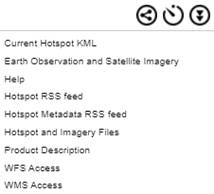
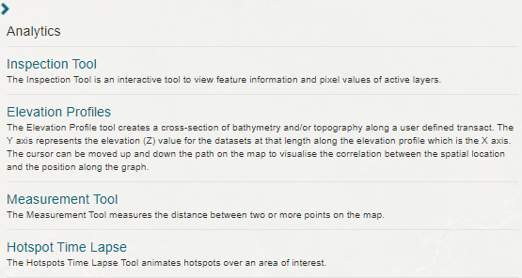
DEA Hotspots
Re-architected to improve reliability / performance
Hardening / Continuous improvement based on user feedback
Features
Near Real Time Sentinel 2A & B
Multiple data access methods
(WxS/files/web map)
Hotspots time lapse
NEW
Portals for emergency management
Notes:
With the newish application:
It was Re-architectured to improved reliability / performance
Hardening of service
Continuous improvement based on user feedback

Slide 6
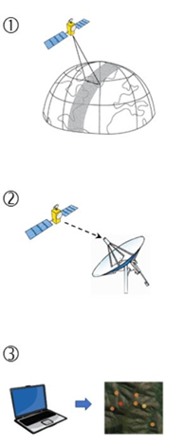
What you need to know
Hotspots are points of unusually high temperature that have been detected via automated analysis of satellite image data.
Satellites take periodic snapshots of the Earth and do not image the same area continuously (1).
In order for a hotspot to be detected, a cloud, smoke-free and unobstructed view of the ground is required.
Hotspots are updated several times each day and available on DEA Hotspots within 30 minutes of the satellite image acquisition from ground stations.
Notes:
What you need to know are Hotspots are generally points of unusually high temperatures, the causes of which range from bushfires, furnaces, industry, and in some cases, hot rocks, or carparks. Satellites take...
In order for a hotspot to... sometimes, through thin cloud or smoke, hotspots can still be detected.

Slide 7
DEA Hotspots role
Provides valuable and timely information to emergency service managers, industry and the general public to help locate potential bushfires that could pose a threat to communities and property.
Provides information only - DEA Hotspots is not an emergency service
Not to be used for safety of life decisions
Notes:
DEA Hotspots information relies on experts like you to interpret the data

Slide 8
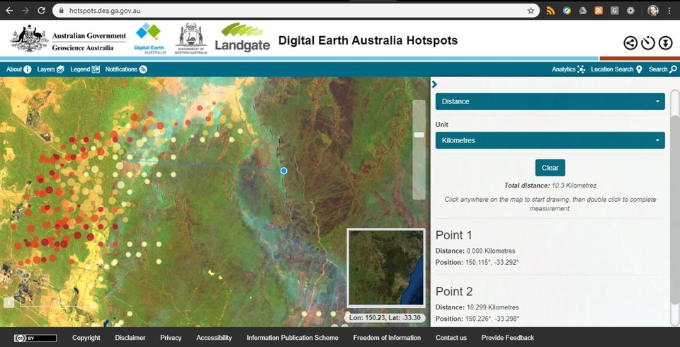
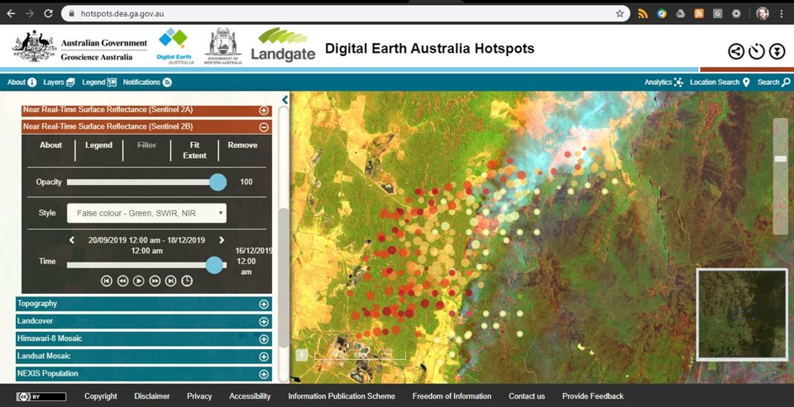
DEA Hotspots
Notes:
Here, you can see an example of the Sentinel 2A and B near real time imagery capability, showing a movement of the fire front of 10km over the course of 5 days, when imagery collection coincided in the same area.

Slide 9
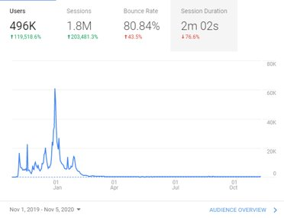
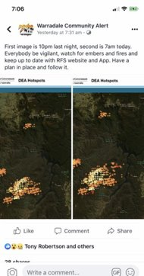
Who uses DEA Hotspots?
Secure site
Utilised by Emergency Services, utilities and resource companies
Dedicated & highly available
Supplemental hotspot sources
Public site
DEA Hotspots filled an information gap for the 2019-20 bushfire season
Reflected in social media and public usage of the tool from Google Analytics
Notes:
DEA Hotspots has two access points, a Secure site and a public site. Since Aug. 2020, both sites have had access to the Himawari-8 Hotspots, coming in at approximately 20 minutes from the geostationary satellite.
over the 2019-20 Australian bushfire crisis, Performance
99% uptime of web service
496K users of the application, the highest occurring during extreme fire danger forecast days

Slide 10
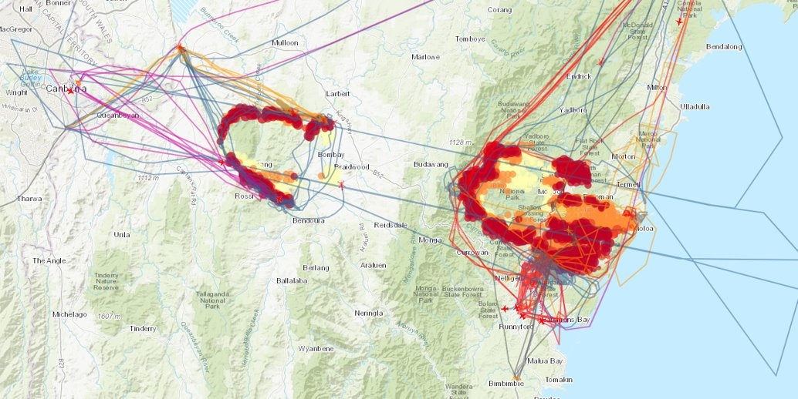
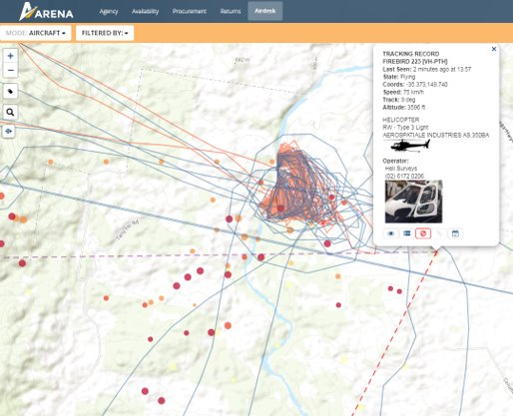
Impact
Situational awareness / spot fires
Remote area monitoring
Infrastructure monitoring
Response planning / coordination
Arena.nafc.org.au
Notes:
As an example of a use case during the Australian Black summer, the National Aerial Firefighting Centre ingested hotspots into their Arena system to give them situational awareness and plan responses to bushfires. Here, you can see the flight paths of aircraft to and from different water sources towards the firefronts.

Slide 11
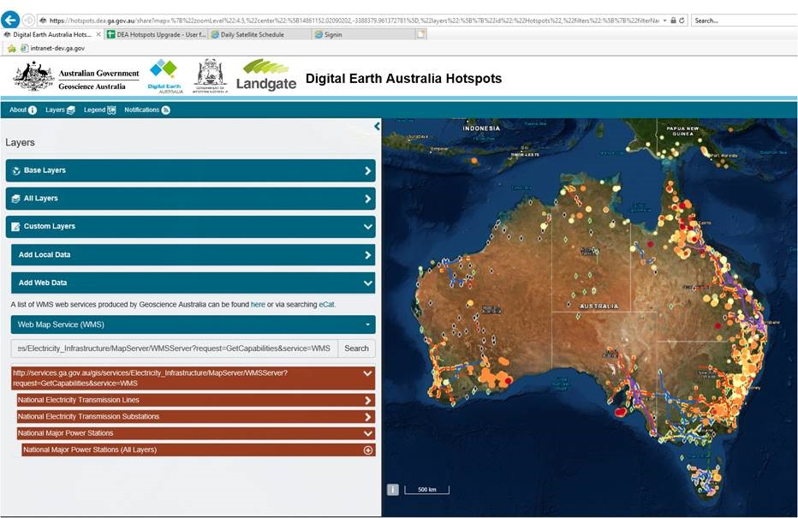
Notes:
SA govt. Use it for identifying and monitoring where possible fires pose risk to infrastructure (department of energy and mining)
Rio Tinto - better security of their power supply system in WA for remote area monitoring
We would love to get ideas from you, the emergency management cohort, on how you use Hotspots, and how you would like to use it in future.

Slide 12
Current
Penetration testing – No security flaws identified
Business Impact Assessment – to ensure Business continuity and recovery plans for DEA Hotspots.
DEA Hotspots has a digital exhibition in Questacon (late 2020), and Adelaide (2021) based on a ‘Earth Observation from Space’ theme
RMIT-GA working to implement a newly developed Himawari-8 algorithm
Application updates: extra data sources (Sentinel 3 - international engagement, user guides).
A new UX specialist has joined our team to review the new website, better understand our users, and align future development with user-driven feedback.
Notes:
Penetration testing – through 3rd party to test and try and uncover flaws relating to availability and data integrity. No flaws detected
BIA, Business continuity

Slide 13
Future
Penetration testing – No security flaws identified
Business Impact Assessment – to ensure Business continuity and recovery plans for DEA Hotspots.
DEA Hotspots has a digital exhibition in Questacon (late 2020), and Adelaide (2021) based on a ‘Earth Observation from Space’ theme
RMIT-GA working to implement a newly developed Himawari-8 algorithm
Application updates: extra data sources (Sentinel 3 - international engagement, user guides).
We are in the process of looking for a UX specialist to review the new website, better understand our users, and align future development with user-driven feedback.
Notes:
We are working with RMIT to hopefully operationalise the newly developed H8 algorithm.
S3VT - As part of an official Sentinel 3 Validation Team project (European Space Agency), Geoscience Australia together with Landgate and NSW Planning Industry and Environment, are working to evaluate the Sentinel 3 SLSTR Fire Radiative Power products from Europe as input to DEA Hotspots.

Slide 14
Team effort
Digital Earth Australia – Business owner
Observatory Operations and Data – Data reception
DiSI Flying Hellfish – Application owners
Client Services team – User interface
Communications team - Promotion
Landgate – Algorithms
ANGSTT
+ many others
Notes:
This work has been supported by a broad internal and external teams,

Slide 15
Thanks!
Portals for emergency management
Notes:
And lastly, thank you to the audience, for joining me today, right before lunch!

