Slide 1
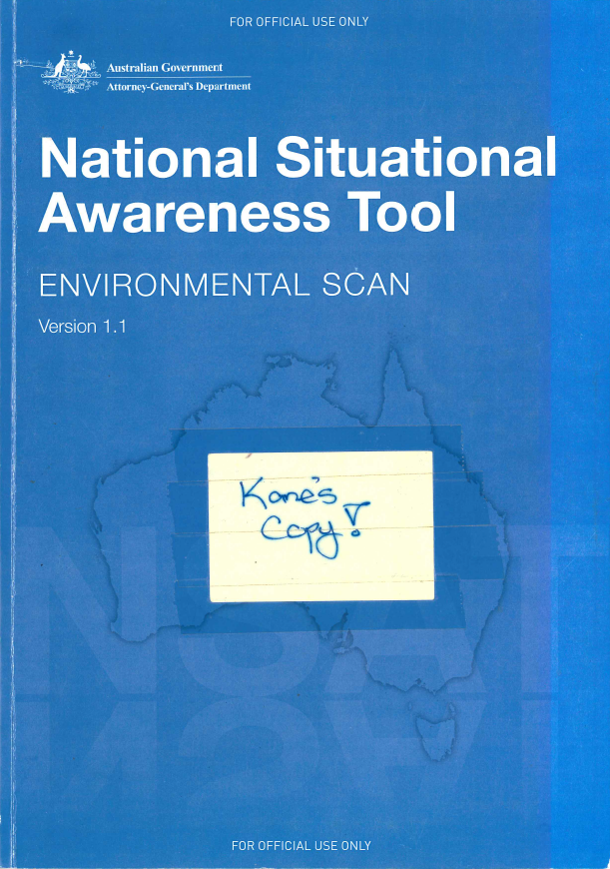
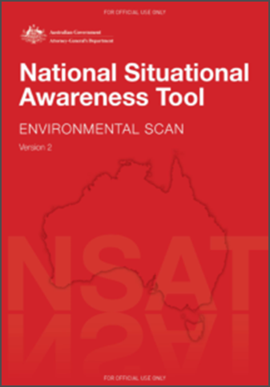
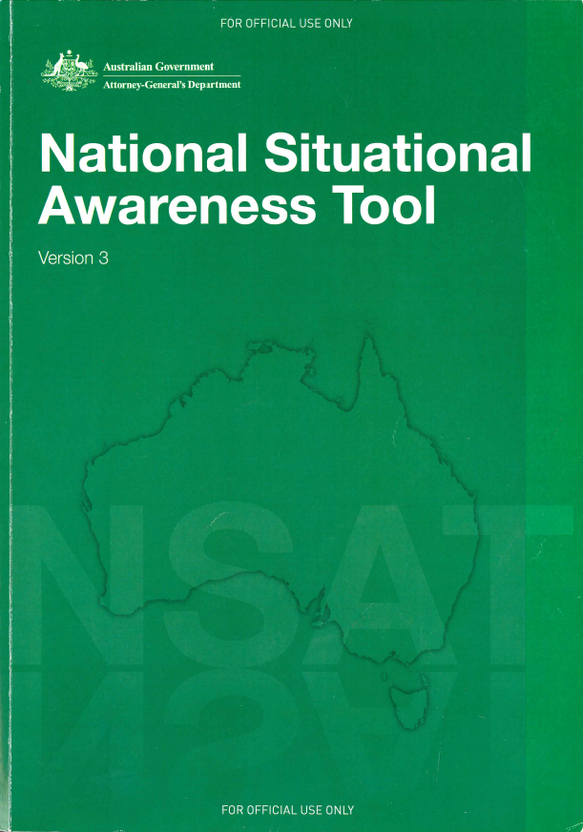
Q1. What is the Project Scope / What is trying to be solved?
The EM-LINK Project is designed to specifically address and solve the following requirements
Enabling quick and easy access to authoritative Emergency Management spatial services across all Australian State’s and Territories.
Ensuring all users have access too and are making informed and consistent decisions upon the same authoritative data.
2012 2013 2014 2016 2017 – present future…

Slide 2
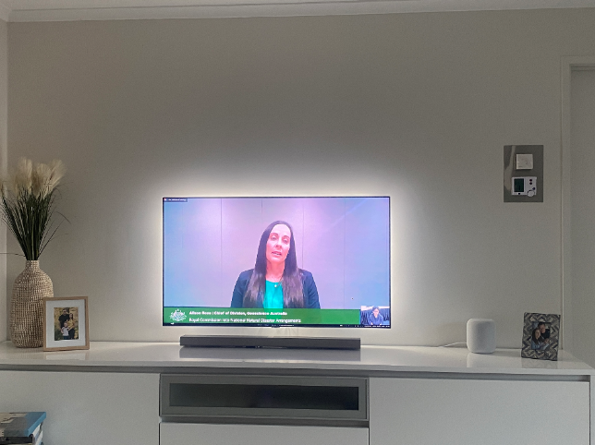
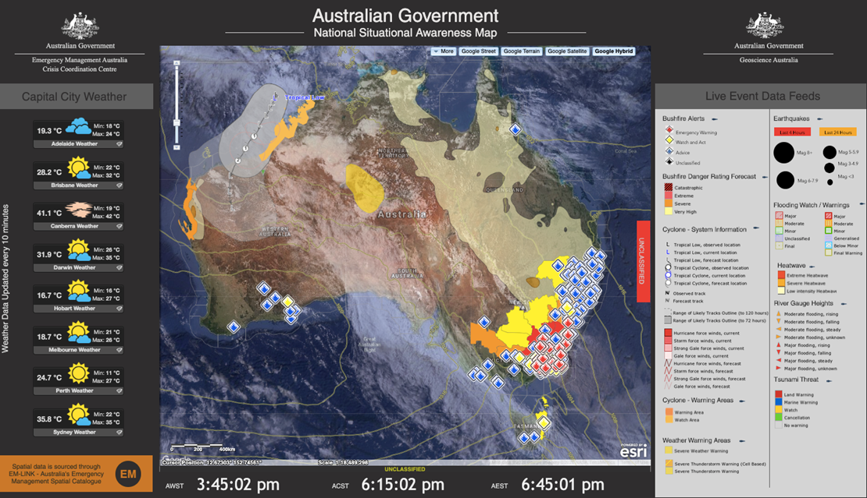
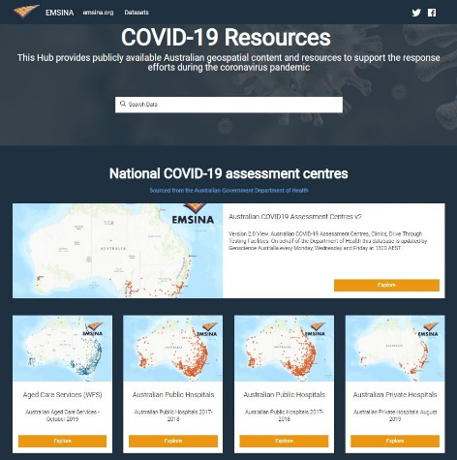
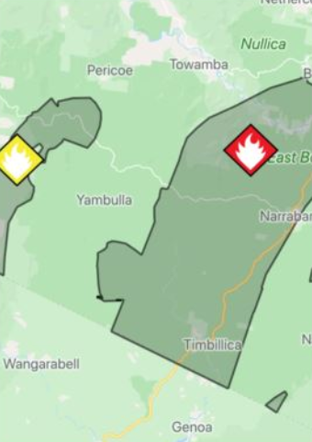
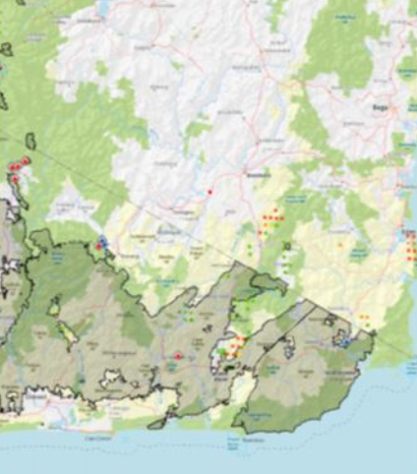
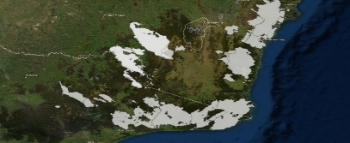
Q2. What will be available to the EM community / decision makers at the end of your project?
Australia’s only National catalogue of authoritative emergency management spatial webservices presented online in a logical and searchable manner.

Slide 3
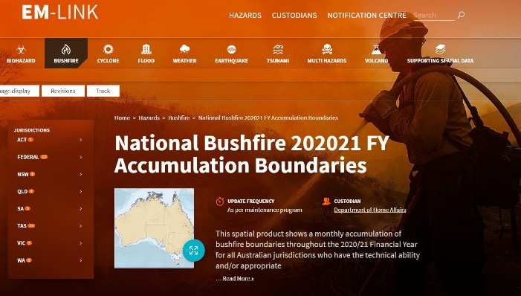
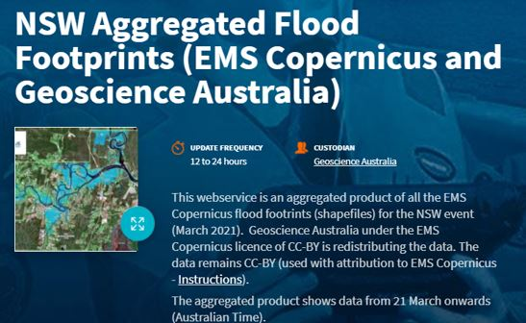
Q3. How will the EM Sector access the results
The Emergency Management LINK catalogue is currently available at:
https://emlink.net.au/
Access is via an online application process
There are currently about 140 EM related webservice profiles
There are approximately 650 active subscribers from Australian/State and Territory governments, industry, education, non-profit agencies.

Slide 4
Q4. What are the main hurdles faced in completing your Project
Resources:
The whole project is run by 1 government employee who is allocated about around 10 hours per month to undertake all Project duties.
Adding and updating of the jurisdictional webservices profiles is primarily achieved via the EM volunteer network; there are no formal arrangements with the data custodians to provide this information.
Updating of content:
Updating of webservice profiles is a manual and time consuming process undertaken by the webservice custodians in a voluntarily manner.
This is unsustainable and the future success of EM-LINK will rely on moving to machine to machine (catalogue to catalogue) content harvesting.
Australian Government Mandate:
There is currently no identified Australian Government department with a formal mandate to the develop and/or address fundamental data gaps regularly identified in EM-LINK.

Slide 5
Q5. What input data / work do you need from jurisdictions
Since 2012 (and through 4 versions of this Project) all state and territory governments have consistently supported this initiative.
Only area of improvement…
A renewed focus on ISO compliant metadata as we move into the machine to machine era of EM-LINK.

Slide 6
