Slide 1
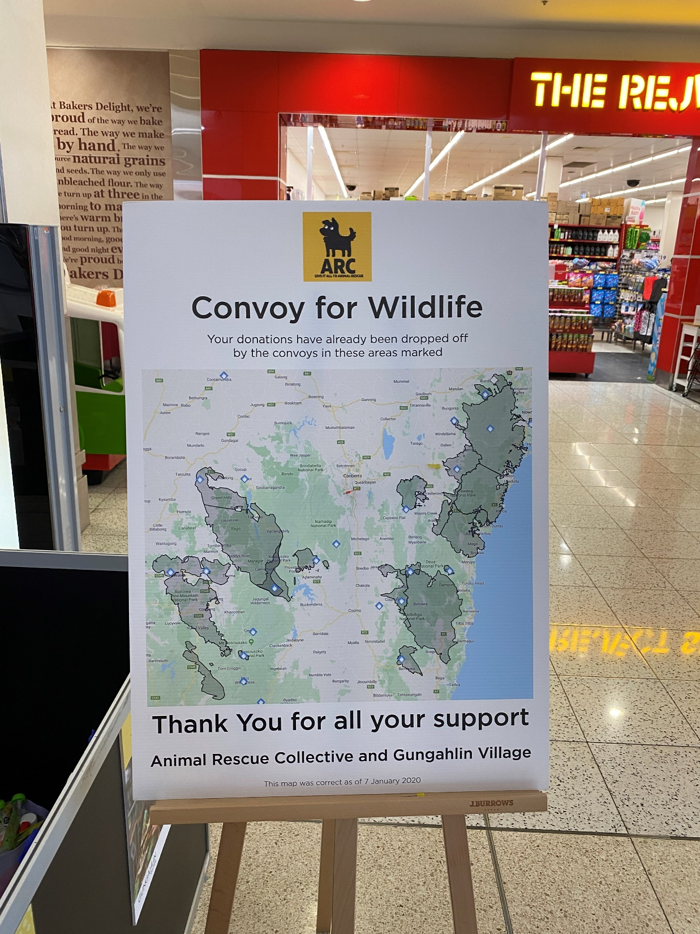
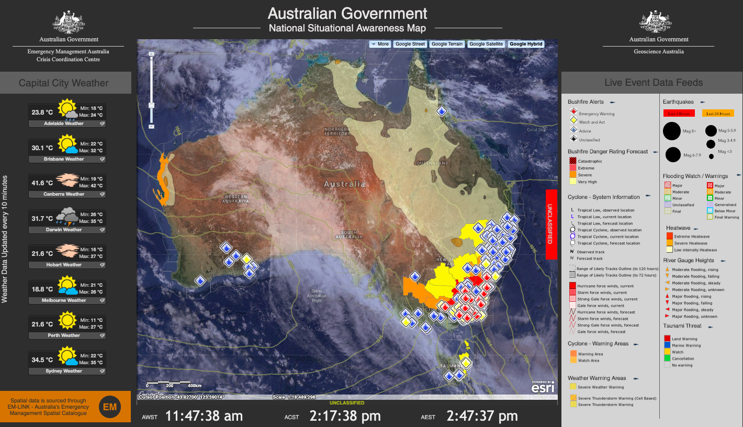
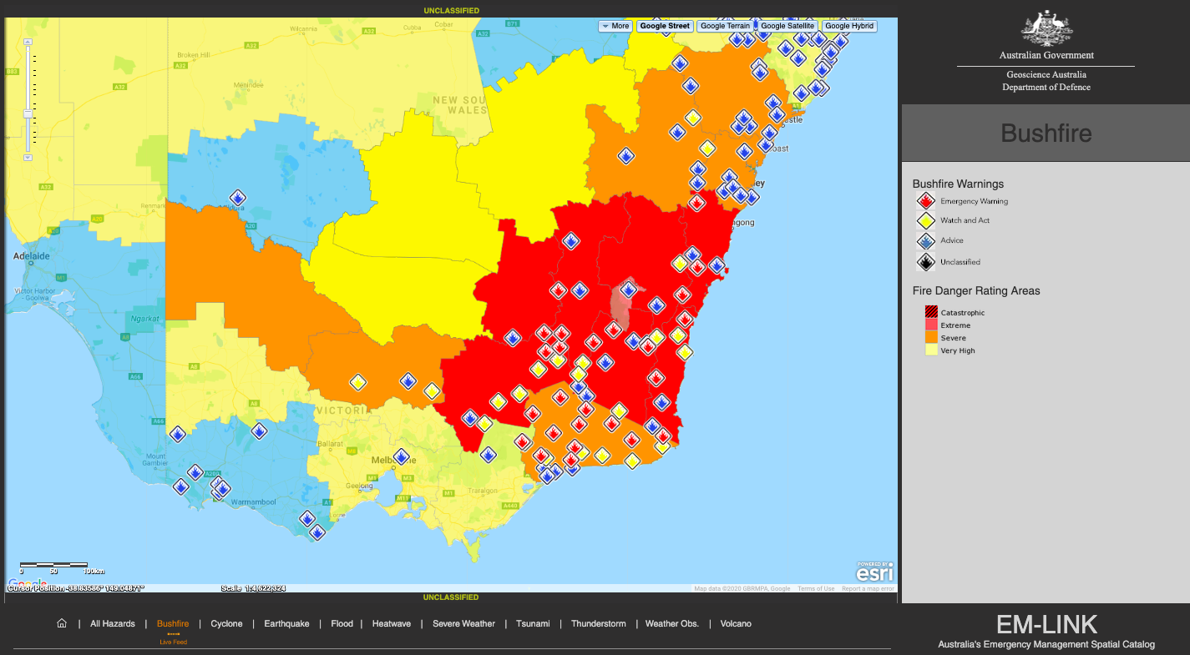
Q1. What is the Project Scope / What is trying to be solved?
The scope of the Department of Home Affairs’ National Bushfire Boundaries Project is to continue on the EMSINA work undertaken during the 2019/20 bushfire season.
This Project is aimed at collecting and aggregating jurisdictional bushfire data into a series of Nationally consistent bushfire boundary spatial products.

Slide 2
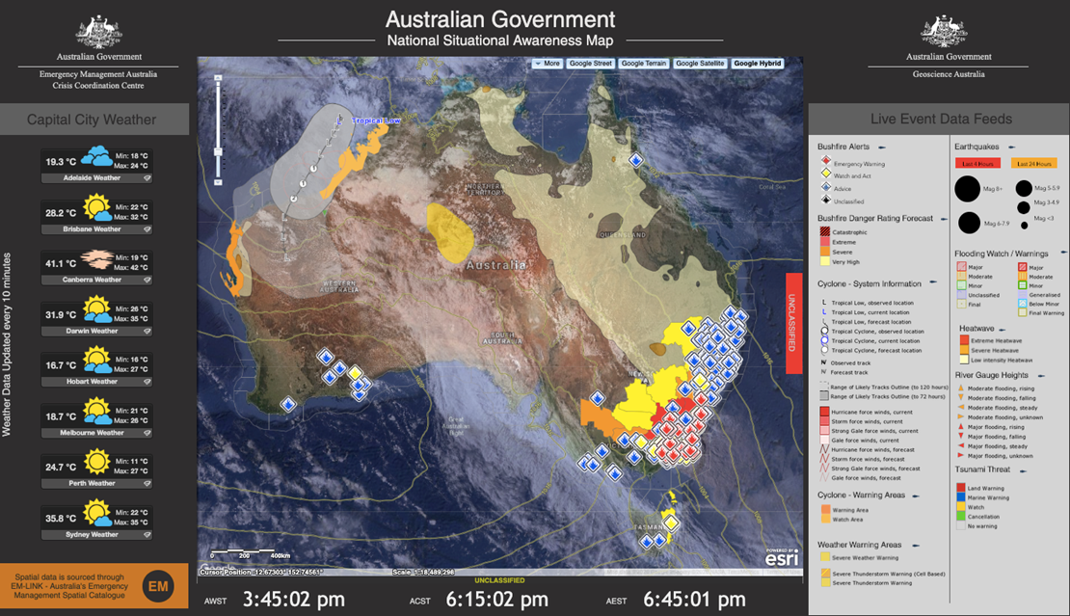
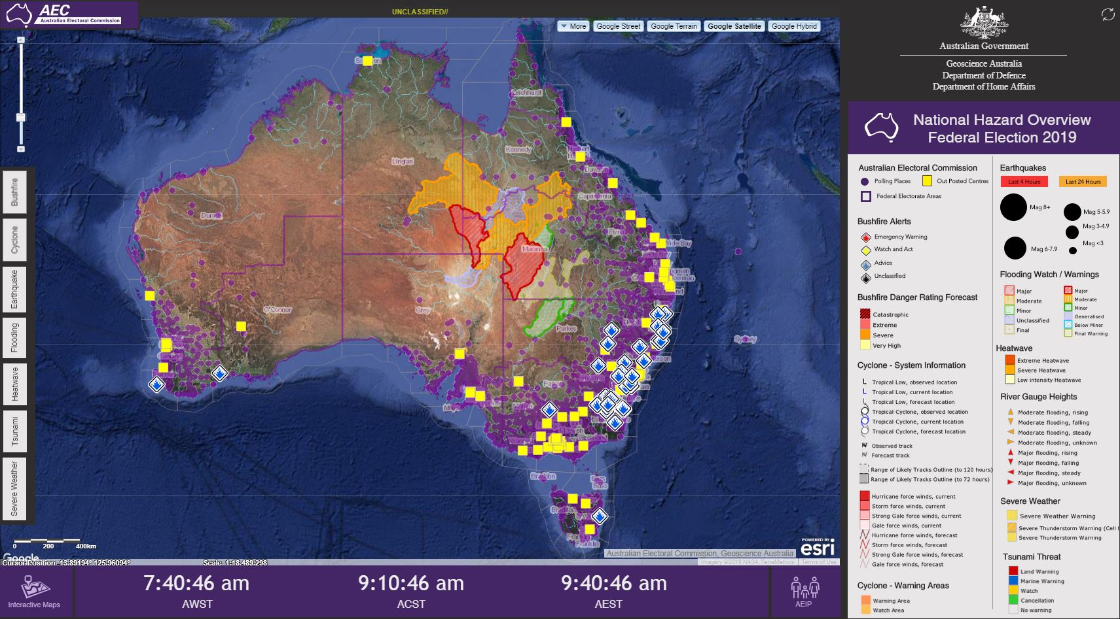
Q2. What will be available to the EM community / decision makers at the end of your project?
The end products available to EM decision makers consist of a series of three bushfire boundary spatial products.
Those products are:
a Bushfire Boundary ‘Operational’ Webservice (updated every 15 minutes)
a Bushfire Boundary ‘Time Series’ Webservice (updated every 3 hours)
a Bushfire Boundary ‘2020/21 FY’ Webservice (updated last day of each month).

Slide 3
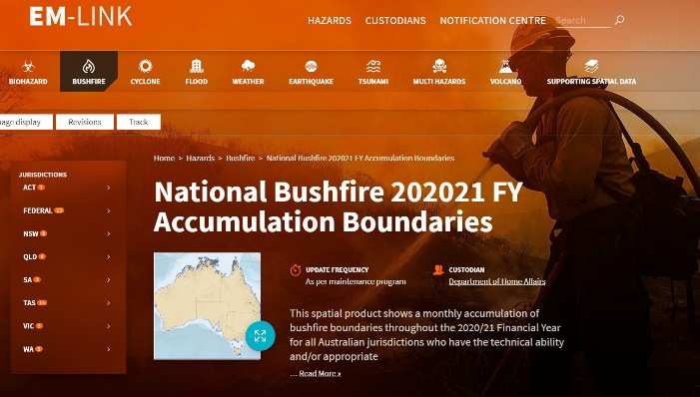
Q3. How will the EM Sector access the results
The data for the three bushfire boundary webservice products can be accessed through EM-LINK.
https://emlink.net.au/.
There are a few other areas we have noticed re-host these data but the latest data and metadata (documentation) is contained within EM-LINK

Slide 4
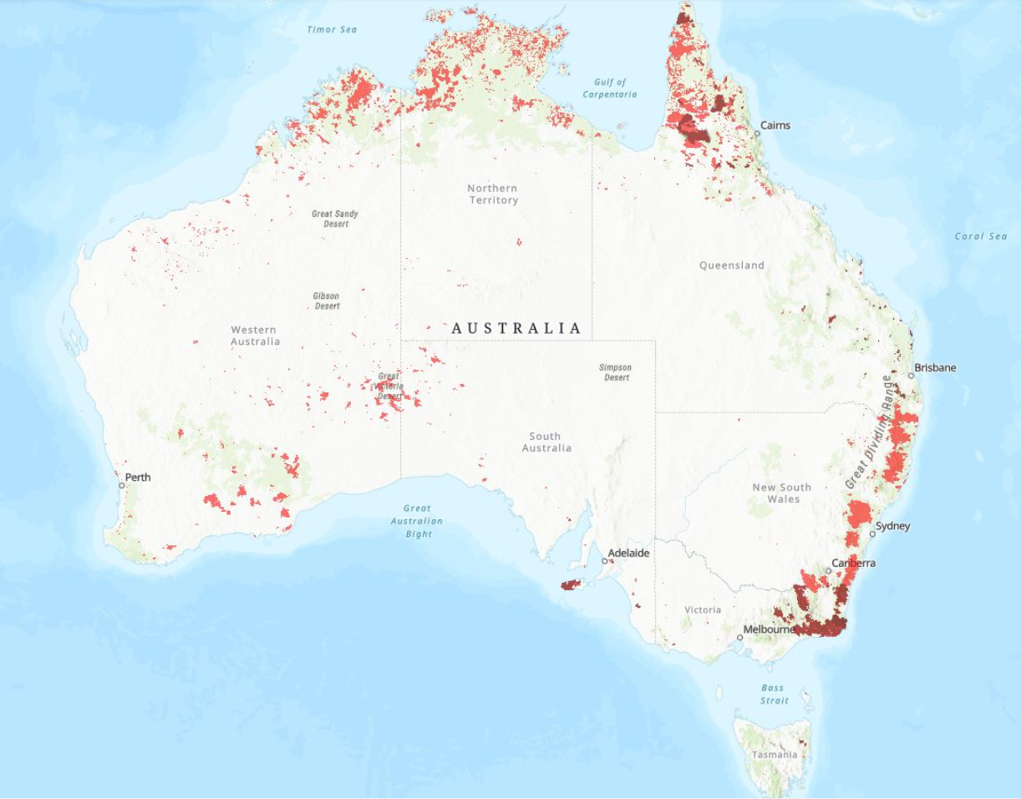
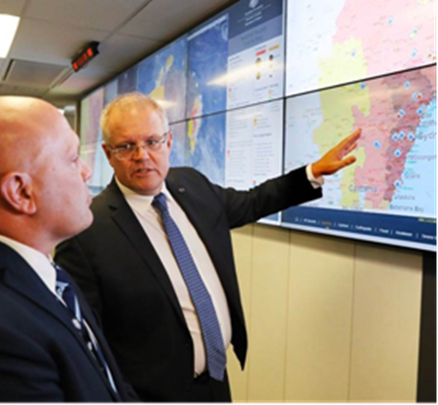
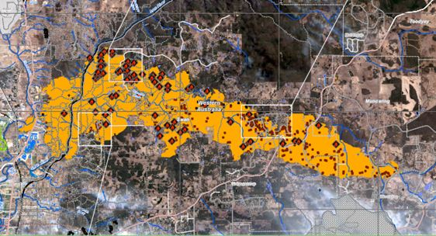
Q4. What are the main hurdles faced in completing your Project
Old State data licencing that does not allow use:
Reliance on a European Service to capture footprints for Australian Government business and other use…
No Australian Government agency with a mandate covering this data (purely voluntary)
Data and attribute standards
Insufficient documentation (metadata) for some of the bushfire boundary webservices
Lack of funding toward and/or recognition that the jurisdictions capabilities hold the key to creating this National bushfire boundary picture
Federal funding (less than $100k fully supported) uncertain for the 2021/22 FY.

Slide 5
Q5. What input data / work do you need from jurisdictions
Overall the Jurisdictions have done an incredible job over the last 15 months in enabling and voluntarily supplying their bushfire data into this National initiative.
The only thing the jurisdictions could do better is to work on their product documentation (metadata).
The Project is at a development stall point where unless an agency/body owns and actively works on solving the underlying data standards a truly Nationally consistent dataset will remain unachievable.
We need targeted State/Federal funding to upgrade and/or enhance jurisdictional capabilities to capture, process and disseminate this data.
Assistance for the Northern Territory to help build and maintain an operational bushfire boundary capability

